Slide 1
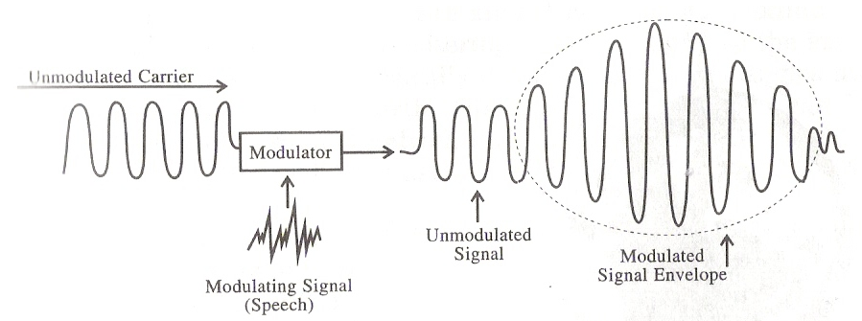
Amplitude Modulation (AM) Transmission and Reception
Signals are transmitted between a transmitter over some form of transmission medium
But normally signals are not in the form that is suitable for transmission and need to be transformed
Modulation is a process of impressing (applying) a low frequency information signals onto a relatively high frequency carrier signal

Slide 2
Why modulation is necessary ?
Signals are transmitted between a transmitter over some form of transmission medium
But normally signals are not in the form that is suitable for transmission and need to be transformed
  Bandwidth requirement
  Signals multiplexing
  Complexity of transmission system
  Preventing noise, interference, attenuation
Modulation is a process of impressing (applying) a low frequency information signals to onto a relatively high frequency carrier signal
Kind of modulation
  Amplitude modulation
  Frequency modulation
  Phase modulation

Slide 3
Principles of AM
Amplitude Modulation – is a process of changing the amplitude of a relatively high frequency carrier signal with the instantaneous value of the modulating signal (information signal)
2 inputs to the modulation devise (modulator)
    A single, high frequency RF carrier signal of constant amplitude
    Low frequency information signals that maybe a single frequency or a complex waveform made up of many frequencies
In the modulator, the information signal modulates the RF carrier signal to produce a modulated waveform made up of many frequencies
This modulated waveform also called as AM envelope

Slide 4
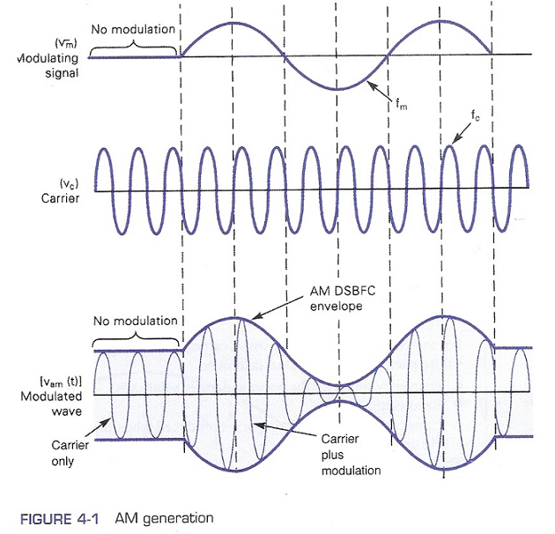
Principles of AM

Slide 5
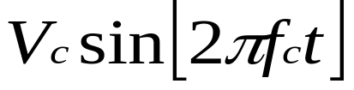
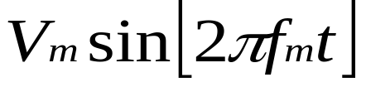
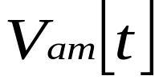
AM Envelope
The most commonly used AM modulation technique is the AM double-sideband full carrier (DSBFC) scheme.
Given a signals representation as follow,
  Carrier signal =
  Modulating signal =
  Modulated wave =
When a modulating signal (information signal) is applied to the carrier signal, the amplitude of the output wave varies in accordance with the modulating signal

Slide 6
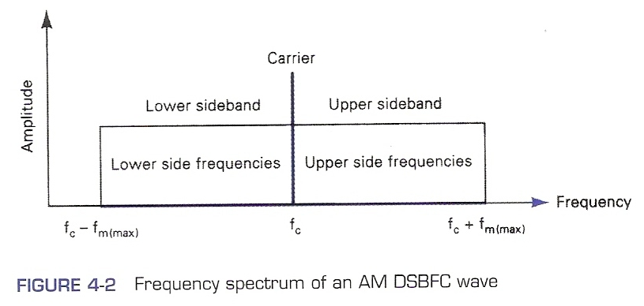
AM Frequency Spectrum and Bandwidth
Output envelop is a complex wave made up of a DC voltage, the carrier frequency, sum frequencies (f_{c} + f_{m}) and difference frequencies (f_{c} –f_{m}).
Sum and difference frequencies are displaced from carrier frequency by an amount equal to modulating frequency.
the AM signal spectrum contains frequency components spaced f_{m} Hz on either side of the carrier as shown below,
the AM spectrum ranges from f_{c} – f_{m(max)} to f_{c} + f_{m(max)}.

Slide 7
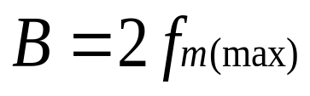
AM Frequency Spectrum and Bandwidth
the AM spectrum ranges from f_{c} – f_{m(max)} to f_{c} + f_{m(max)}.
Parameters :
  Lower sideband (LSB) = band of frequencies between f_{c} – f_{m(max)} and f_{c}
  Lower side frequency (LSF) = any frequency within LSB
  Upper sideband (USB) = band of frequencies between f_{c} and f_{c} + f_{m(max)}
  Upper side frequency (USF) = any frequencies within USB
Bandwidth : twice the highest modulating signal frequency

Slide 8
AM Frequency Spectrum and Bandwidth
Ex : For an AM DSBFC modulator with a carrier frequency f_{c} = 100 kHz and a maximum modulating signal frequency f_{m(max)} = 5 kHz, determine
a) Frequency limits for the upper and lower sidebands.
b) Bandwidth
c) Upper and lower side frequencies produced when the modulating signal is a single-frequency 3-kHz tone.
d) Draw the output frequency spectrum

Slide 9
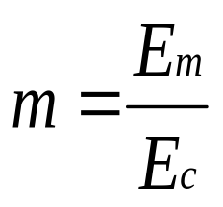
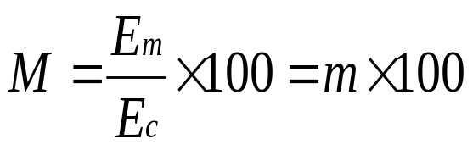
Coefficient of Modulation and Percent Modulation
Coefficient of Modulation is a term used to describe the amount of amplitude change presents in an AM waveform
Percent Modulation is the coefficient of modulation stated as a percentage
Mathematical representation :
(1)
(2)
where m = modulation coefficient where usually 0 < m ≤ 1
M = percent modulation
E_{m} = peak change in the amplitude of the output waveform
E_{c} = peak amplitude of the unmodulated carrier waveform

Slide 10
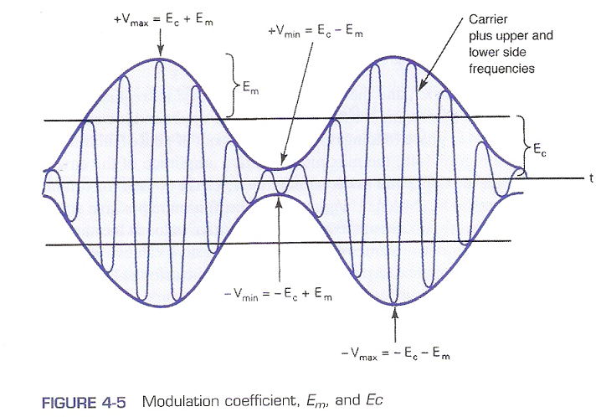
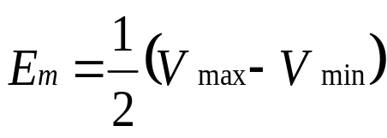
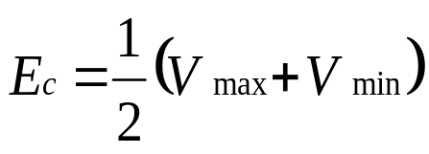
Coefficient of Modulation and Percent Modulation
Graphical representation of the relationship between m, E_{m} and E_{c}
Based from the above figure, (3)
(4)

Slide 11
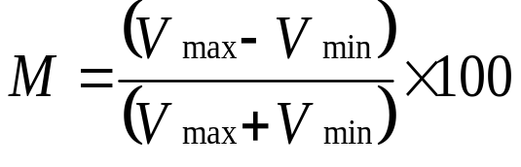
Coefficient of Modulation and Percent Modulation
Graphical representation of the relationship between m, E_{m} and E_{c}
(5)

Slide 12

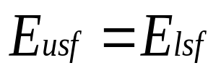
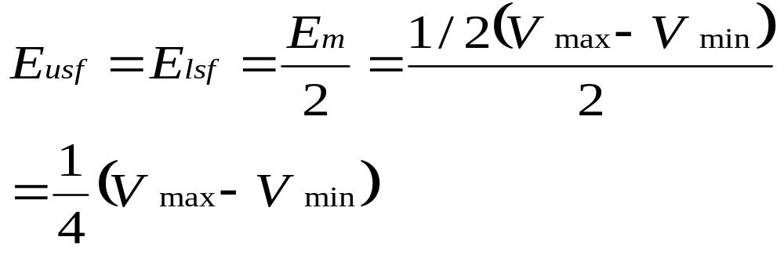
Coefficient of Modulation and Percent Modulation
E_{m} can also be defined as the sum of voltages from upper and lower side frequencies
(6)
then from
(7)
(8)
where E_{usf} = peak amplitude of the upper side frequency (volts)
E_{lsf} = peak voltage of the lower side frequency (volts)

Slide 13
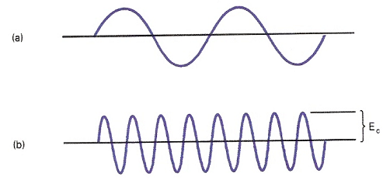
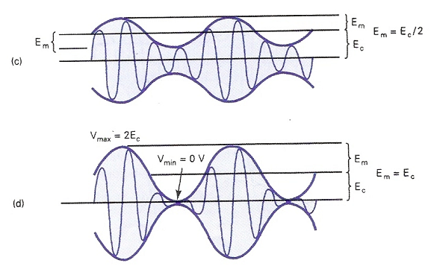
Coefficient of Modulation and Percent Modulation
It can be seen that percent modulation goes to 100% when E_{m} = E_{c}.
At 100% modulation, the minimum amplitude of the amplitude V_{min} = 0.
Maximum percent modulation that can be imposed without causing excessive distortion is 100%.

Slide 14
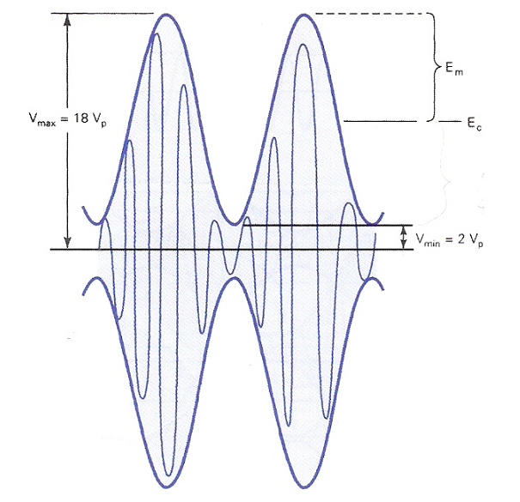
Coefficient of Modulation and Percent Modulation
Ex : For the AM waveform shown below, determine
  a) Peak amplitude of the upper and lower side frequencies
  b) Peak amplitude of the unmodulated carrier
  c) Peak change in the amplitude of the envelope
  d) Coefficient of modulation
  Percent modulation

Slide 15
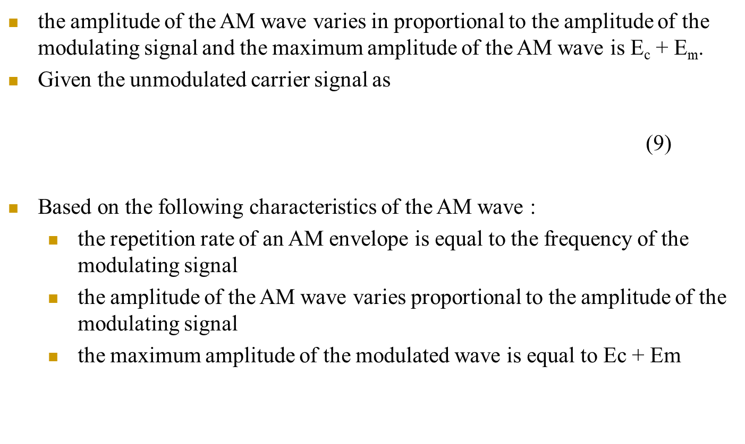
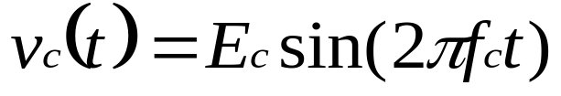
AM Voltage Distribution and Analysis

Slide 16
AM Voltage Distribution and Analysis
therefore, the output modulated wave can be expressed as
(11)
where E_{c} = peak carrier signal amplitude
f_{c} = carrier signal frequency
f_{m} = modulating signal frequency
E_{m} = peak change of the modulated output signal amplitude
= amplitude of modulating signal

Slide 17
AM Voltage Distribution and Analysis
substituting (1) into (11),
(12)
rearranging equation (12), we get
(13)
Here it can be seen that the output modulated signal contains a constant component and a sinusoidal component at the modulating signal frequency.
Next, by expanding equation (13),
(14)

Slide 18
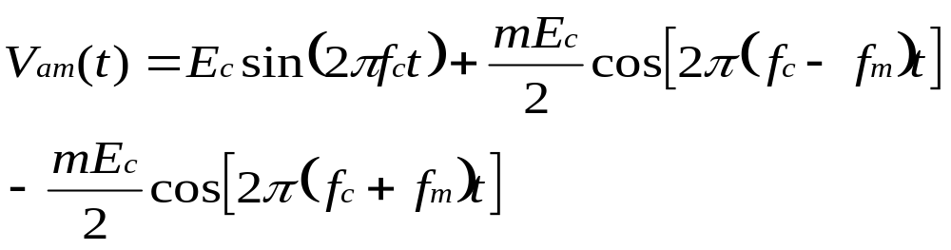
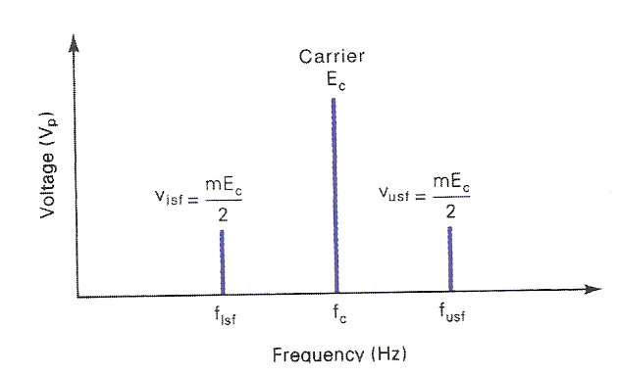
AM Voltage Distribution and Analysis
Then by using a trigonometric function, equation (14) can be represented as,
(15)
Below figure shows voltage spectrum representing the AM DSBFC wave based on equation (15).

Slide 19
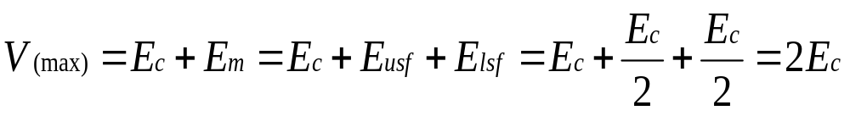
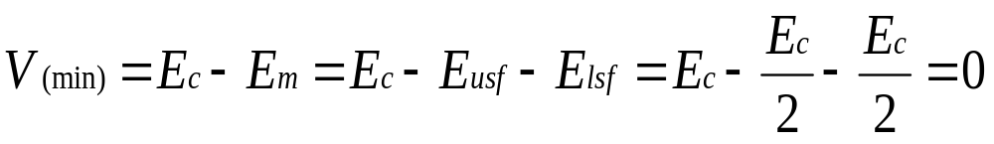
AM Voltage Distribution and Analysis
From equation (15) there are few characteristics of AM DSBFC that can be deduced as follow :
  1. the amplitude of the carrier signal is unaffected by the modulation process.
  2. the amplitude of USF and LSF depends on both the carrier amplitude and the coefficient of modulation.
  3. for 100% modulation (m = 1) and from previous section,
  i.e. the maximum peak amplitude of an AM envelope is V_{(max)} = 2E_{c} and the minimum peak amplitude of the envelope is V_{(min)} = 0.

Slide 20
AM Voltage Distribution and Analysis
Ex : One input to the conventional AM modulator is a 500 kHz carrier with an amplitude of 20Vp. The second input is a 10 kHz modulating signal that is of sufficient amplitude to cause a change in the output wave of ±7.5 Vp. Determine
  a. Upper and lower side frequencies
  b. Modulation coefficient and percent modulation.
  c. Peak amplitude of the modulated carrier and the upper and lower side frequency voltages.
  d. Maximum and minimum amplitudes of the envelope.
  e. Expression for the modulated wave.
  f. Draw the output spectrum.
  g. Sketch the output envelope.

Slide 21
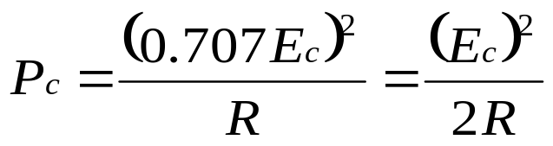
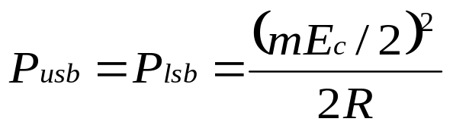
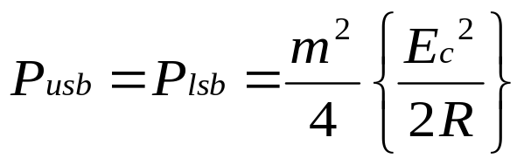
AM Power Distribution
the average power dissipated in a load by an unmodulated carrier is equal to the rms carrier voltage divided by the load resistance.
(16)
the upper and lower sideband powers, P_{usf} and P_{lsf} respectively are given as,
(17)
rearranging equation (17),
(18)

Slide 22
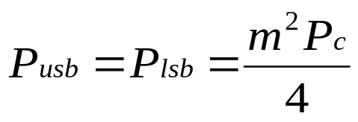
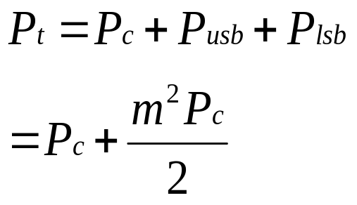
AM Power Distribution
Substituting equation (16) into (18),
(19)
total power in an amplitude-modulated wave is equal to the sum of powers of the carrier, the upper sideband and the lower sideband represented as follow,
(20)
Note that the total power in an AM envelope increases with modulation m.

Slide 23
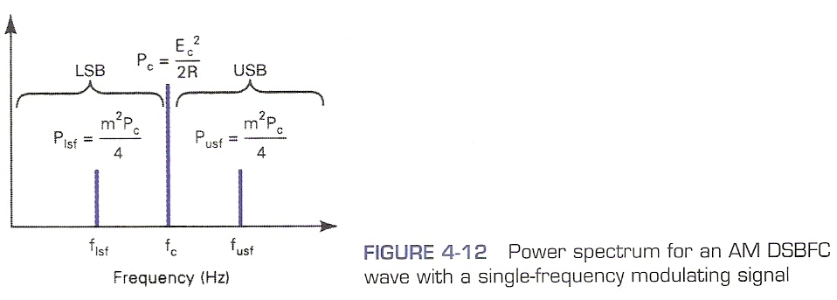
AM Power Distribution
Power spectrum for an AM DSBFC wave.

Slide 24
AM Power Distribution
Ex : For an AM DSBFC wave with a peak unmodulated carrier voltage V_{c} = 10 Vp, a load resistance R_{L} = 10Ω, and a modulation coefficient m = 1, determine
  a. Powers of the carrier and the upper and lower sidebands.
  b. Total sideband power.
  c. Total power of the modulated wave.
  d. Draw the power spectrum.
  e. Repeat steps (a) through (d) for modulating index m = 0.5.

Slide 25
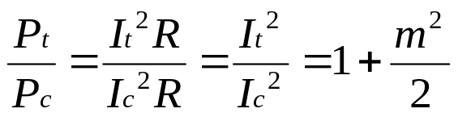
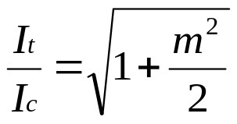
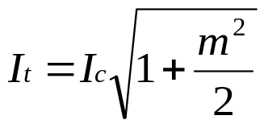
AM Current Calculations
Modulation index can be calculated by measuring the current of the carrier and the modulated wave.
The measurement is simply by metering the transmit antenna current with and without the presence of the modulating signal.
The relationship between the carrier current and the current of the modulated wave is
(21)
and (22)
Thus, (23)

Slide 26
AM Current Calculations
where P_{t} = total transmit power (watts)
P_{c} = carrier power (watts)
I_{t} = total transmit current (ampere)
I_{c} = carrier current (ampere)
R = antenna resistance (ohm)

Slide 27
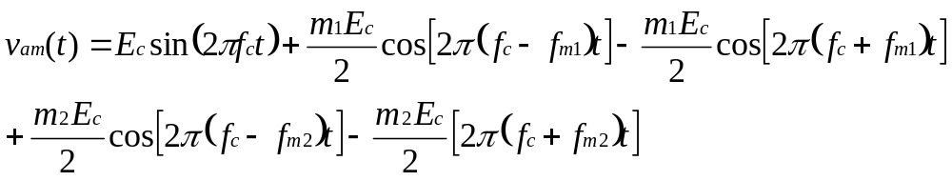
Modulation by a Complex Information Signal
In the previous section, voltage and power distribution for AM DSBFC wave were analyzed for a single modulating signal.
However in practice, the modulating signal is often a complex waveform made up of many sine waves with different amplitudes and frequencies.
Consider a modulating signal containing 2 frequencies : f_{m1} and f_{m2}. The modulated wave obtained will contain the carrier and two sets of side frequencies space symmetrically about the carrier frequency.
(24)

Slide 28
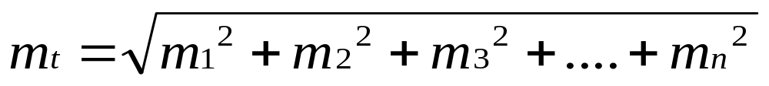
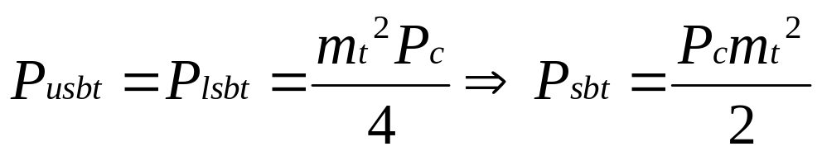
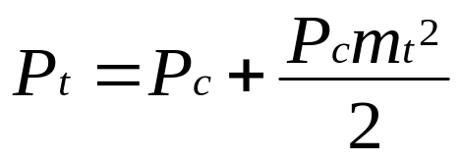
Modulation by a Complex Information Signal
For coefficient of modulation for a case involving several modulating frequencies,
(25)
where m_{t} = total coefficient of modulation
m₁, m₂, m₃ and m_{n} = coefficient of modulation for signal 1, 2, 3 and n
Consequently, the combined coefficient of modulation, m_{t} can be used to determine the total sideband and total transmitted powers as follow,
(26)
Thus,
(27)

Slide 29
Modulation by a Complex Information Signal
where P_{usbt} = total upper sideband power
P_{lsbt} = total lower sideband power
P_{sbt} = total sideband power
P_{t} = total transmitted power
Ex : For an AM DSBFC transmitter with an unmodulated carrier power P_{c} = 100W that is modulated simultaneously by 3 modulating signals with coefficient of modulation m₁ = 0.2, m₂ = 0.4 and m₃ = 0.5, determine
  a. Total coefficient of modulation
  b. Upper and lower sideband power
  c. Total transmitted power

Slide 30
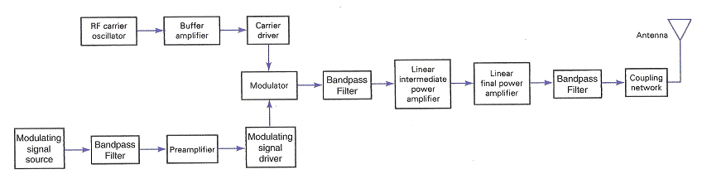
AM Transmitters
Low-level Transmitters
Block diagram for a low-level AM DSBFC transmitter :
  Preamplifier
    Linear voltage amplifier with high input impedance.
    To raise source signal amplitude to a usable level with minimum nonlinear distortion and as little thermal noise as possible.
  Modulating signal driver
    Amplifies the information signal to an adequate level to sufficiently drive the modulator.

Slide 31
Low-level Transmitters
Block diagram for a low-level AM DSBFC transmitter :
  RF Carrier oscillator
    To generate the carrier signal.
    Usually a crystal-controlled oscillator is used.
  Buffer amplifier
    Low gain, high input impedance linear amplifier.
    To isolate the oscillator from the high power amplifiers.
  Modulator : can use either emitter collector modulation
  Intermediate and final power amplifiers (pull-push modulators)
    Required with low-level transmitters to maintain symmetry in the AM envelope

Slide 32
Low-level Transmitters
  Coupling network
    Matches output impedance of the final amplifier to the transmission line/antenna
Applications are in low-power, low-capacity systems : wireless intercoms, remote control units, pagers and short-range walkie-talkie

Slide 33
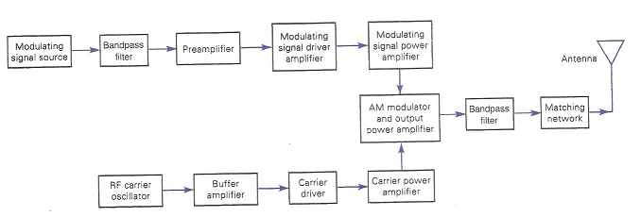
High-level Transmitters
Block diagram for a high-level AM DSBFC transmitter
  Modulating signal is processed similarly as in low-level transmitter except for the addition of power amplifier
  Power amplifier
    To provide higher power modulating signal necessary to achieve 100% modulation (carrier power is maximum at the high-level modulation point).
  Same circuit as low-level transmitter for carrier oscillator, buffer and driver but with addition of power amplifier

Slide 34
High-level Transmitters
  Primary functions of modulator circuit
    Provide the necessary circuitry for the modulation to occur
    The final power amplifier
    Frequency-up converter : translates low-frequency information signals to radio-frequency signals that can be efficiently radiated from the antenna and propagates through the free space

